Slide 1
Optimization Objectives:
Utilitarian Efficiency
Commute Sufficiency
Trip Sufficiency
Accessibility Sufficiency
Metrics:
Commute-based
Trip-based
Accessibility-based
Varying parameters
nCar:
0
3000
4000
5000
Tsuff:
15
20
25
Nsuff:
30
35
40

Slide 2
Summary

Slide 3
Tsuff = 20 min
Metric/nCar | 0 | 3000 | 4000 | 5000
Travel Time | 18,5554 | 13,2742 | 12,3377 | 11,6381
Commute | 8,0990 | 0,4829 | 0,2002 | 0,0966
Trip | 8,0990 | 0,4965 | 0,2037 | 0,0954
Utilitarian Efficiency
Travel Time | - | 13,3870 | 12,3692 | 11,6431
Commute | - | 0,0648 | 0,0648 | 0,0648
Trip | - | 0,2018 | 0,1125 | 0,0756
Commute Sufficiency
Travel Time | - | 13,9572 | 13,0791 | 13,0025
Commute | - | 0,1091 | 0,0648 | 0,0648
Trip | - | 0,1093 | 0,0648 | 0,0648
Trip Sufficiency

Slide 4
nCar = 4000
Metric/Tsuff | 15 | 20 | 25
Travel Time | 12,3377 | 12,3377 | 12,3377
Commute | 1,4728 | 0,2002 | 0,0226
Trip | 1,5162 | 0,2037 | 0,0226
Utilitarian Efficiency
Travel Time | 13,3711 | 12,3692 | 12,3466
Commute | 0,4112 | 0,0648 | 0,0121
Trip | 0,7467 | 0,1125 | 0,0176
Commute Sufficiency
Travel Time | 12,7655 | 13,0791 | 14,4433
Commute | 0,7097 | 0,0648 | 0,0121
Trip | 0,7124 | 0,0648 | 0,0121
Trip Sufficiency

Slide 5
Tsuff = 20 min, nCar = 4000
Metric/Nsuff | 30 | 35 | 40
Travel Time | 13,1732 | 13,0244 | 12,9705
Commute | 0,9818 | 0,8945 | 0,7469
Trip | 0,9867 | 0,8945 | 0,7530
Accessibility-Trip | 0,0002 | 0,0011 | 0,0034
Note: Accessibility-Trip and Accessibility-Commute have the same values in this optimization due to the definition of the problem (same as with trip sufficiency)
Accessibility Sufficiency
Accessibility-Commute | 0,0312 | 0,0745 | 0,1765
Accessibility-Trip | 0,0376 | 0,0830 | 0,1839
Commute Sufficiency
TT = 12,3692
Accessibility-Commute | 0,0063 | 0,0401 | 0,1395
Accessibility-Trip | 0,0063 | 0,0401 | 0,1395
Trip Sufficiency
TT = 13,0791

Slide 6
Details
Varying nCar and Tsuff

Slide 7
nCar = 0
No Cars

Slide 8
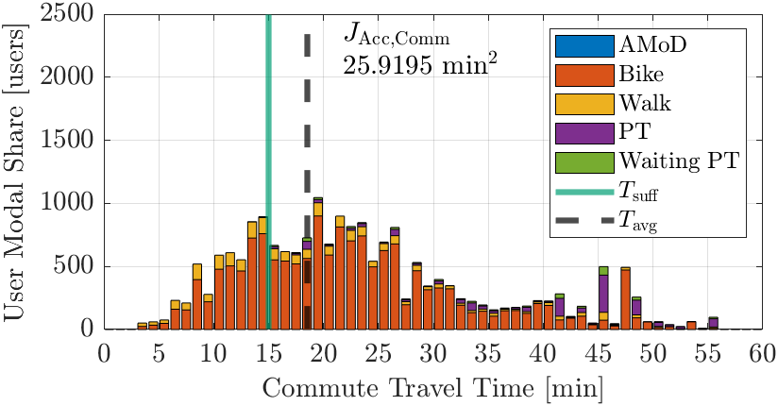
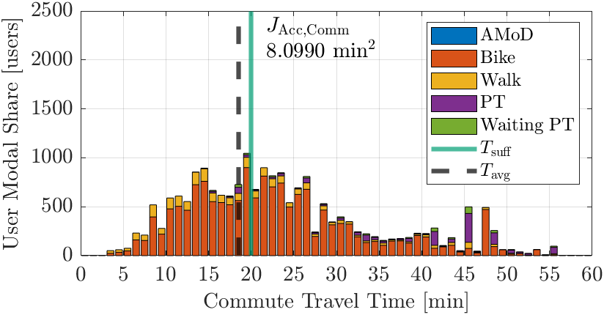




Utilitarian Efficiency
Metric
Commute
Trip
Tsuff
15 min
20 min
25 min

Slide 9
nCar = 3000

Slide 10
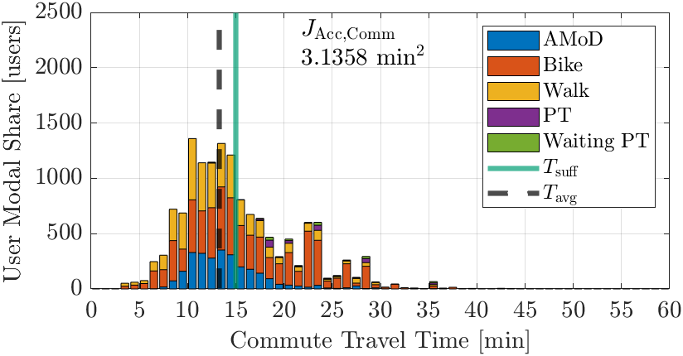
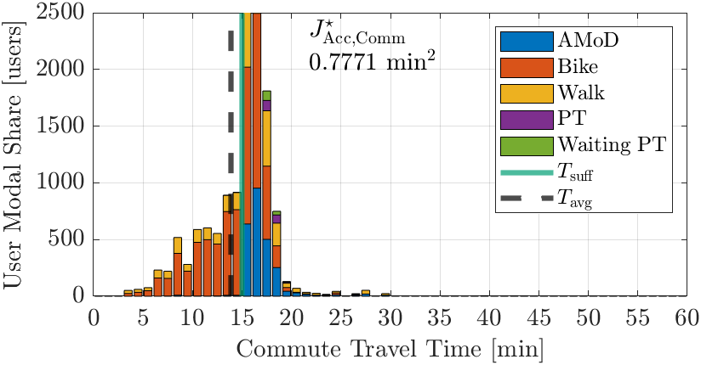
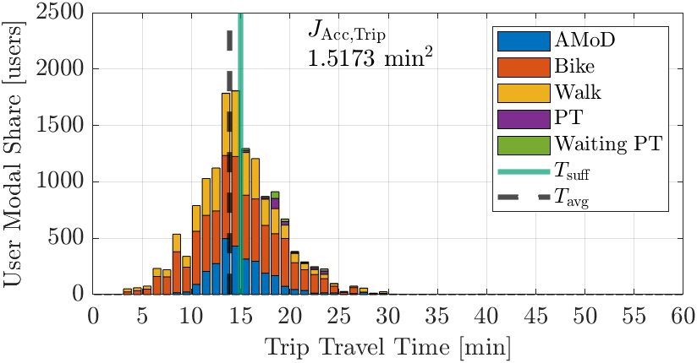
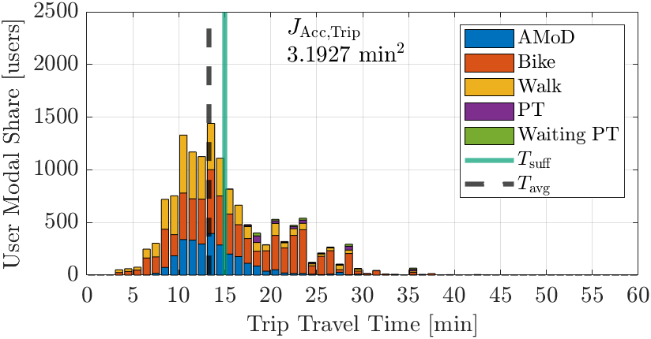

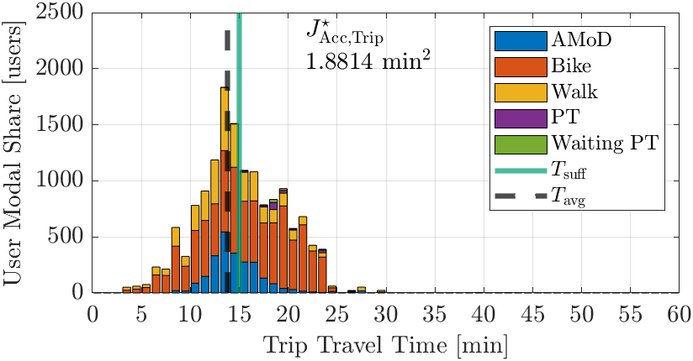
Tsuff = 15 min
Metric
Commute
Trip
Objective
Utilitarian Efficiency
Commute Sufficiency
Trip Sufficiency

Slide 11
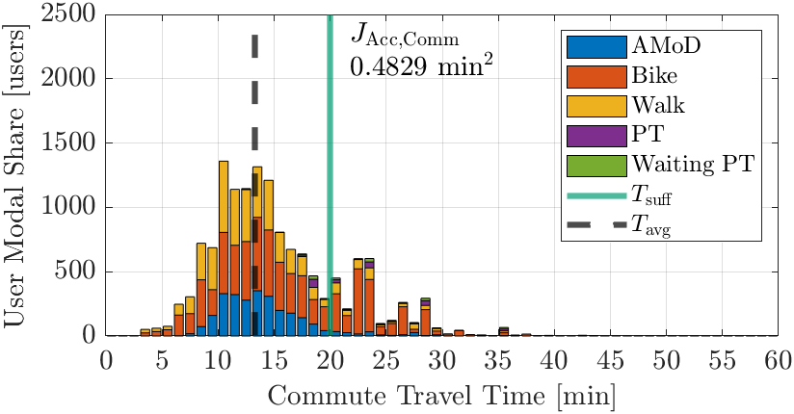
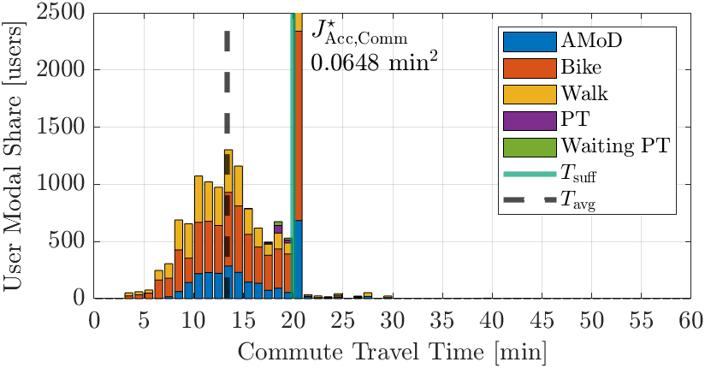
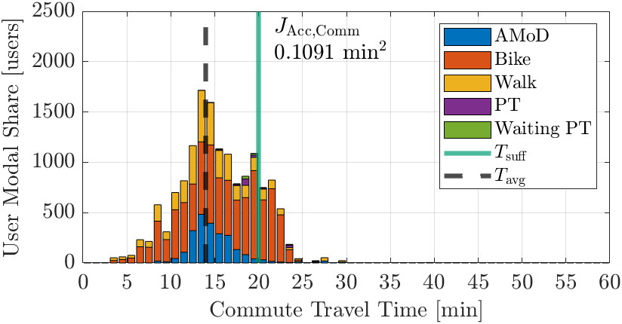

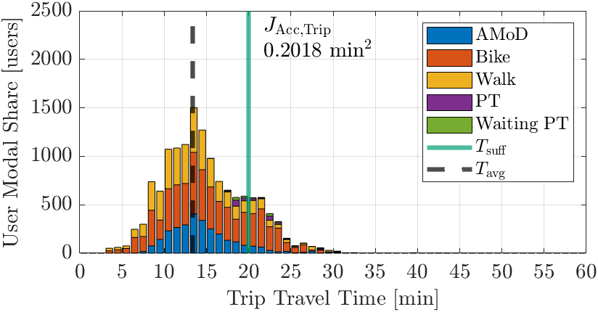

Tsuff = 20 min
Metric
Commute
Trip
Objective
Utilitarian Efficiency
Commute Sufficiency
Trip Sufficiency

Slide 12

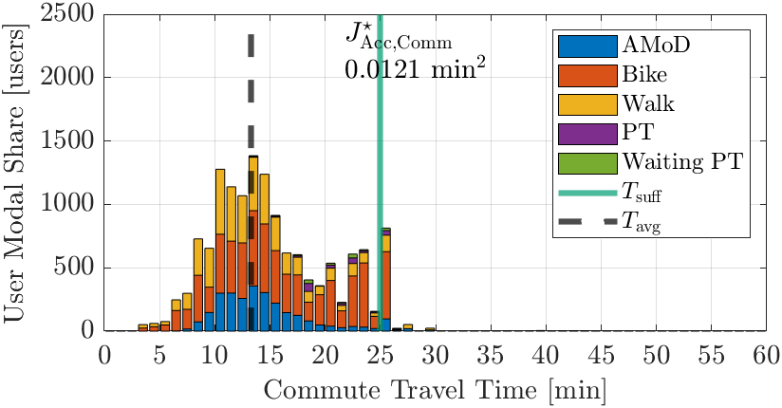
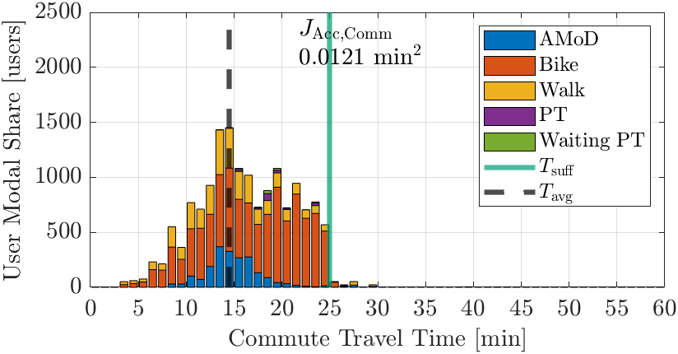
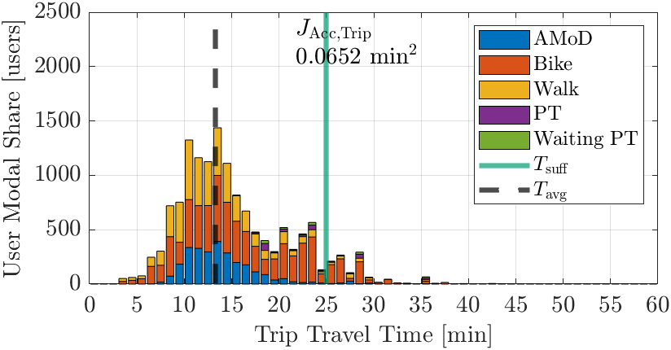
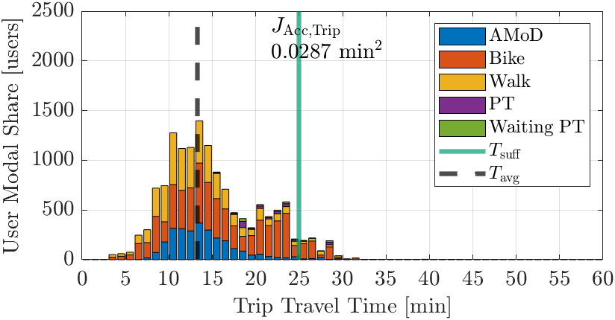
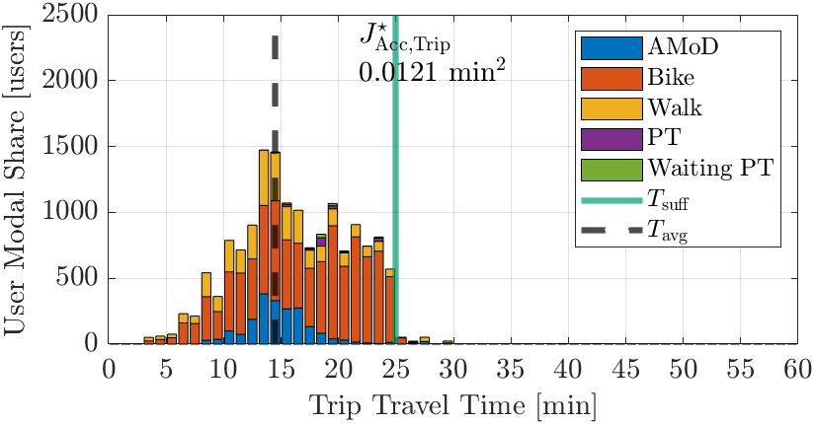
Tsuff = 25 min
Metric
Commute
Trip
Objective
Utilitarian Efficiency
Commute Sufficiency
Trip Sufficiency

Slide 13
nCar = 4000

Slide 14
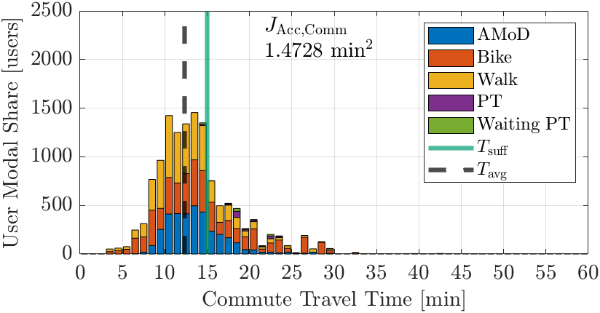
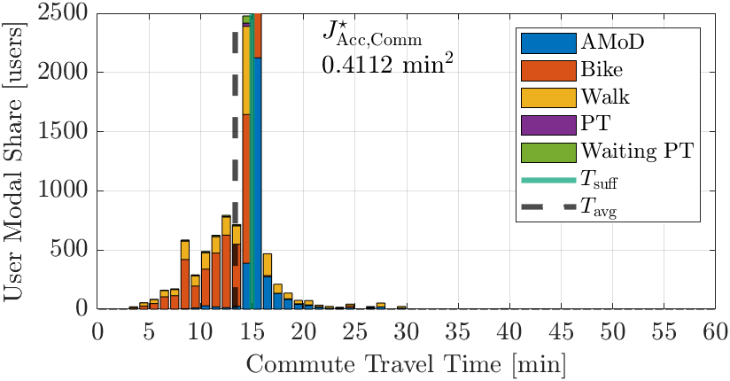
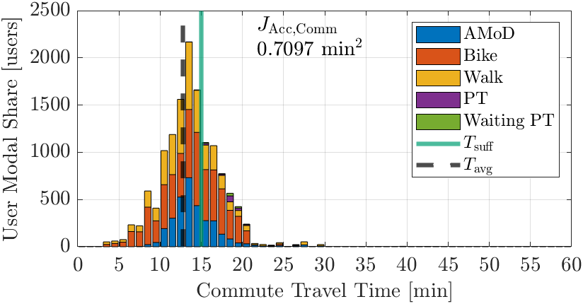

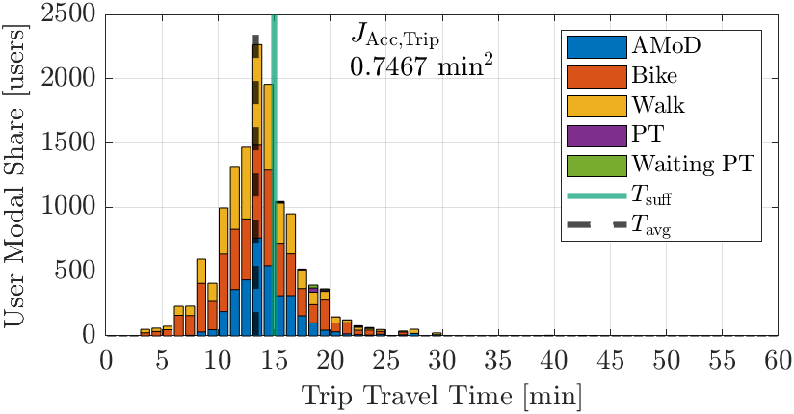
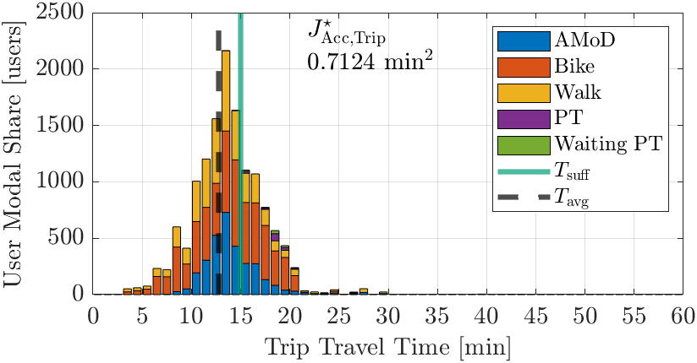
Tsuff = 15 min
Metric
Commute
Trip
Objective
Utilitarian Efficiency
Commute Sufficiency
Trip Sufficiency

Slide 15
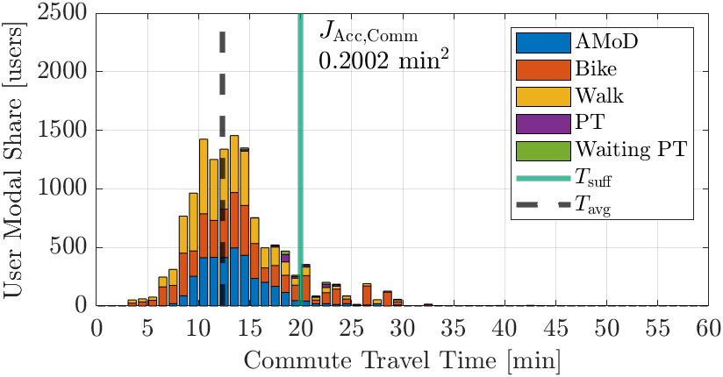
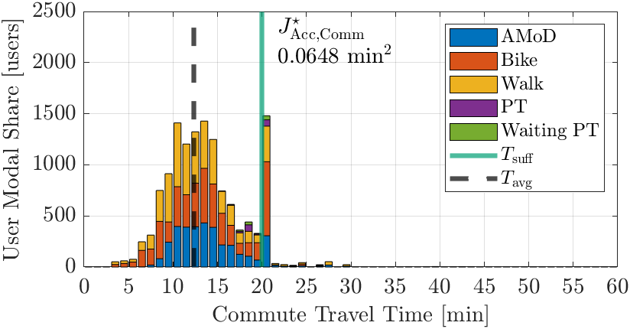
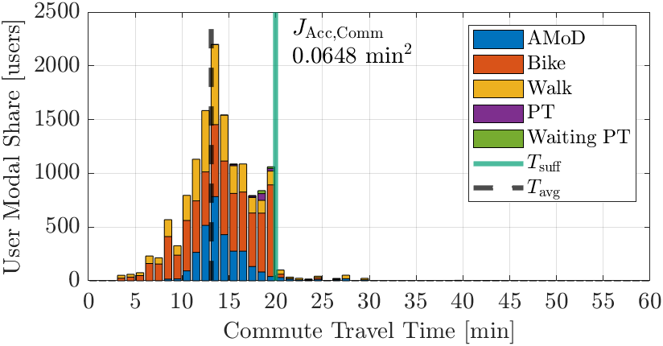


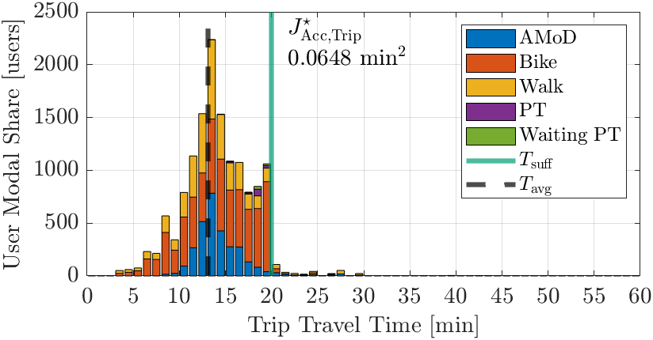
Tsuff = 20 min
Metric
Commute
Trip
Objective
Utilitarian Efficiency
Commute Sufficiency
Trip Sufficiency

Slide 16
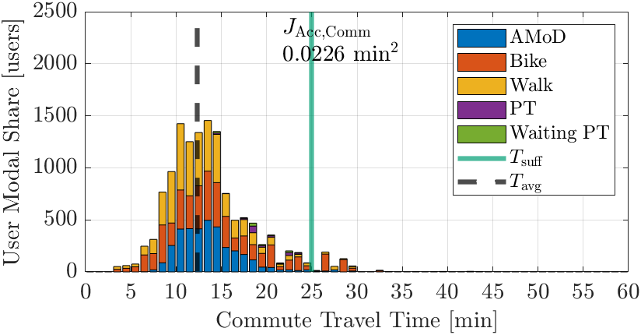





Tsuff = 25 min
Metric
Commute
Trip
Objective
Utilitarian Efficiency
Commute Sufficiency
Trip Sufficiency

Slide 17
nCar = 5000

Slide 18
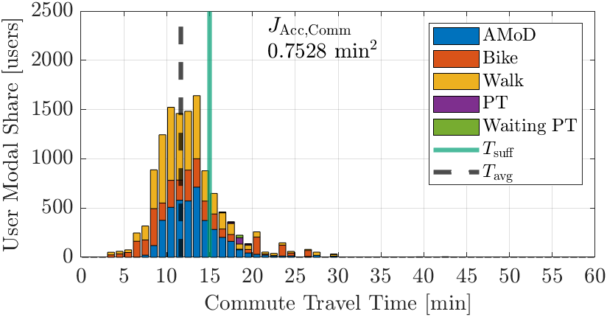
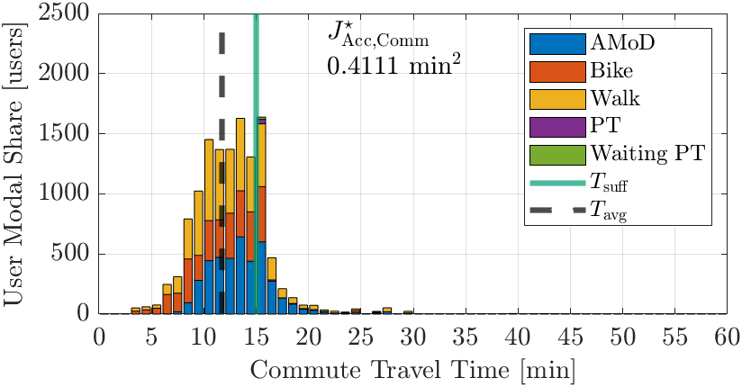
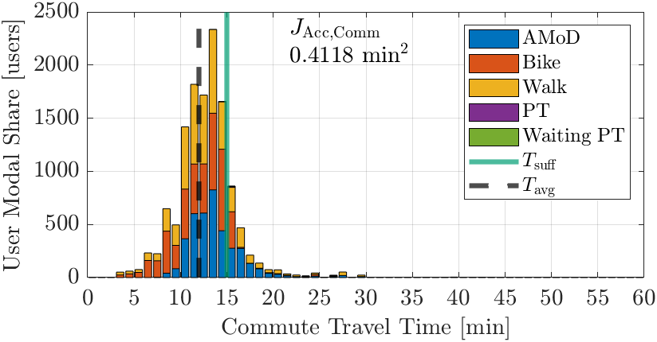
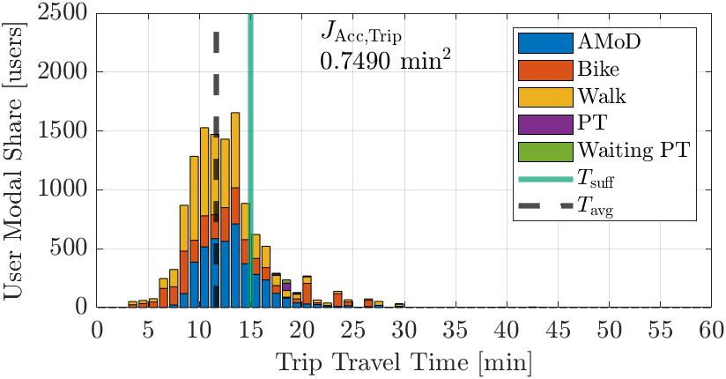
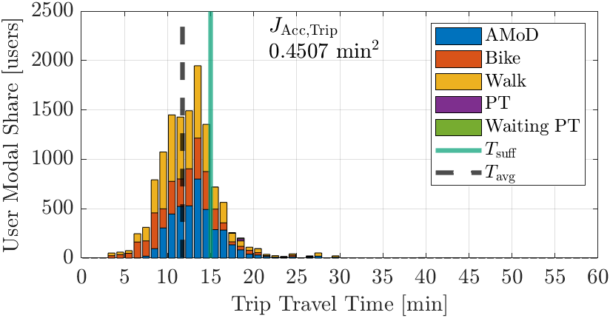
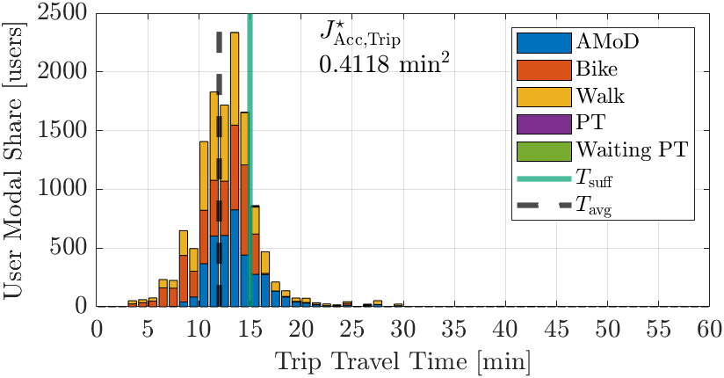
Tsuff = 15 min
Metric
Commute
Trip
Objective
Utilitarian Efficiency
Commute Sufficiency
Trip Sufficiency

Slide 19
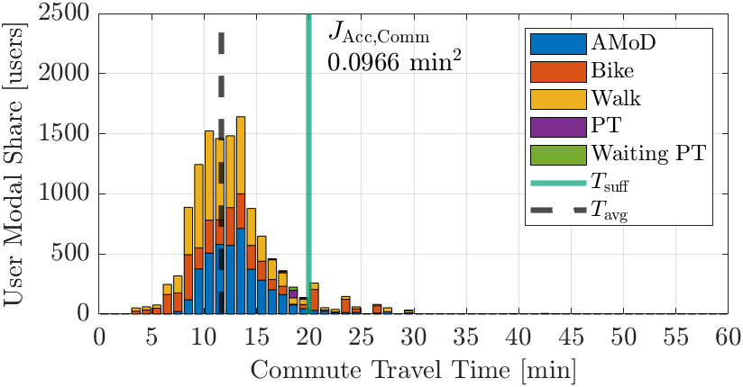
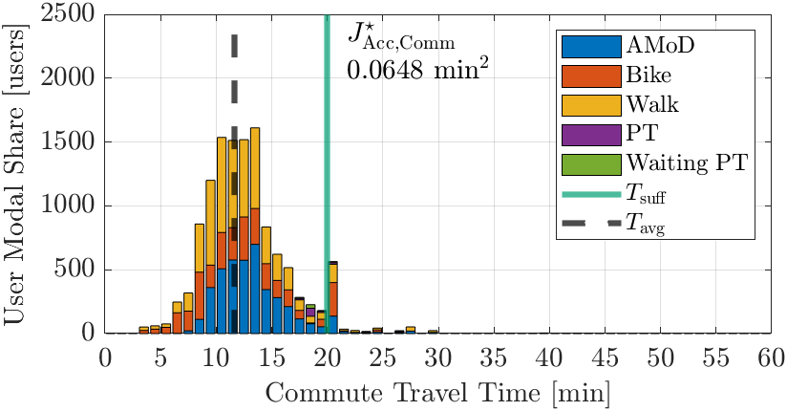



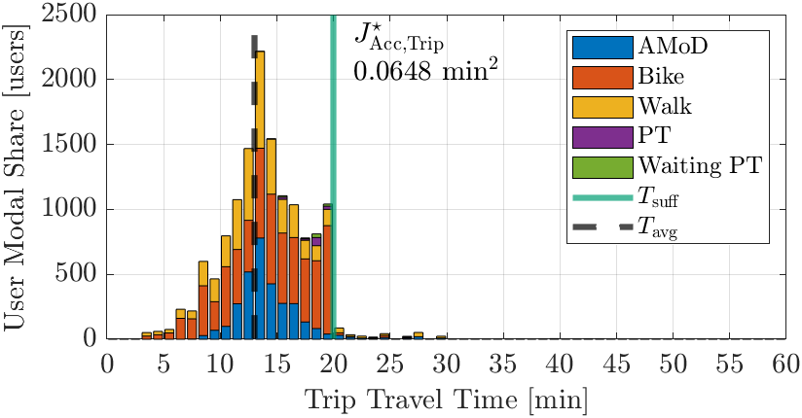
Tsuff = 20 min
Metric
Commute
Trip
Objective
Utilitarian Efficiency
Commute Sufficiency
Trip Sufficiency

Slide 20




Tsuff = 25 min
Metric
Commute
Trip
Objective
Utilitarian Efficiency
Commute Sufficiency
Trip Sufficiency

Slide 21
Details
Varying Nsuff, nCar and Tsuff

Slide 22
Nsuff = 30

Slide 23
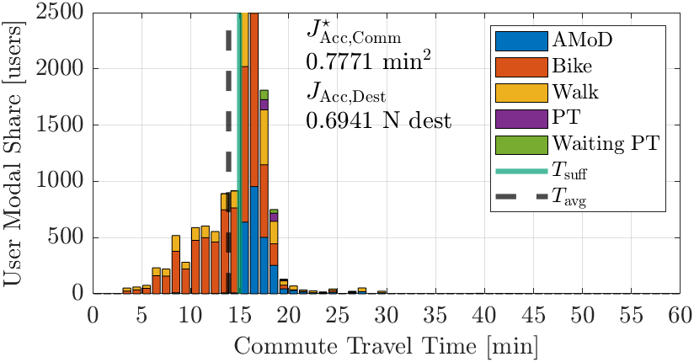
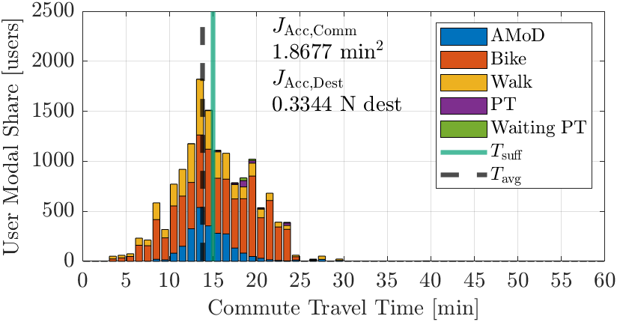
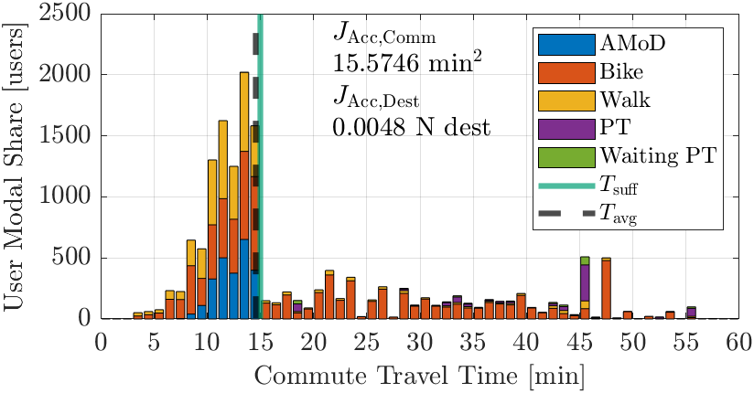
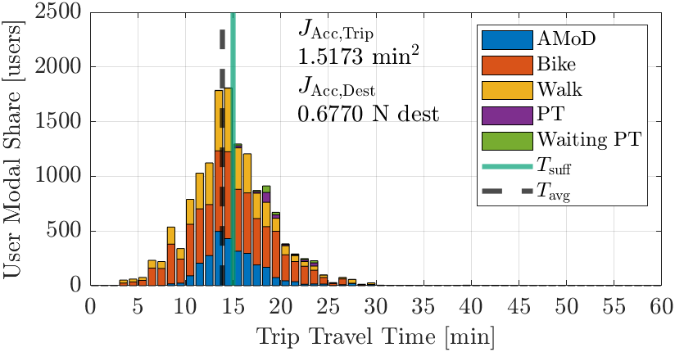


nCar = 3000, Tsuff = 15 min
Metric
Commute
Trip
Objective
Commute Sufficiency
Trip Sufficiency
Accessibility Sufficiency

Slide 24
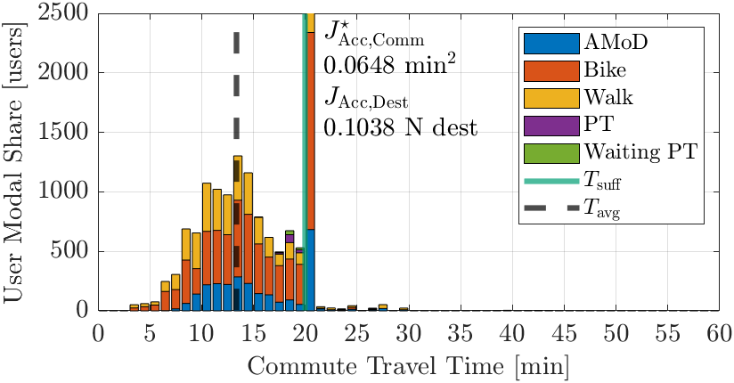

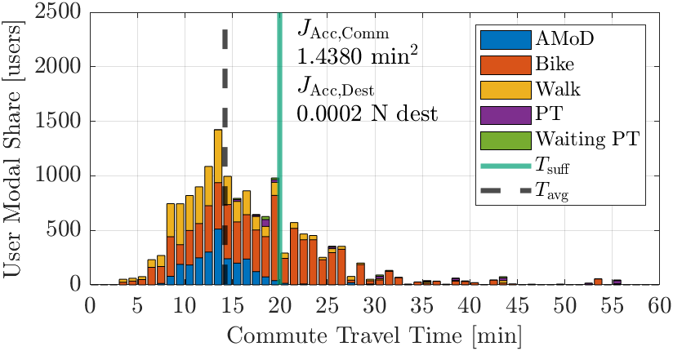
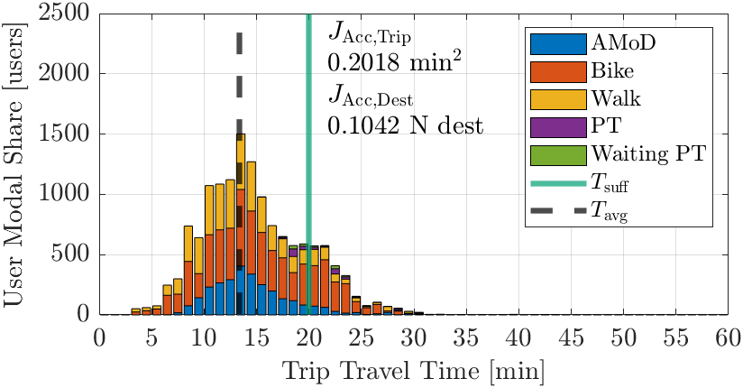

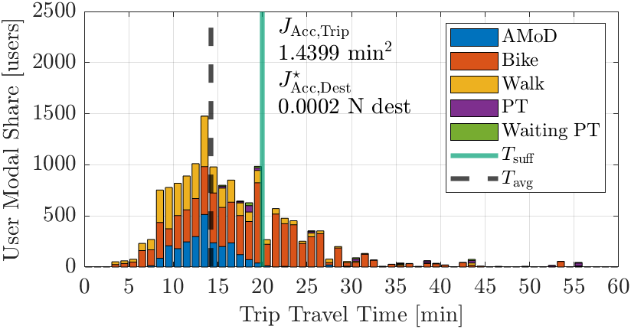
nCar = 3000, Tsuff = 20 min
Metric
Commute
Trip
Objective
Commute Sufficiency
Trip Sufficiency
Accessibility Sufficiency

Slide 25
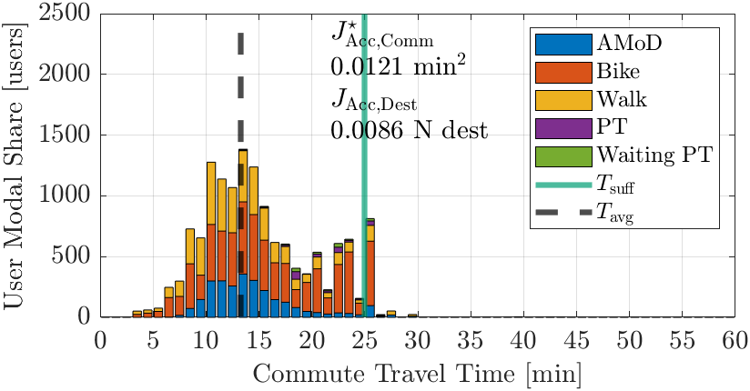
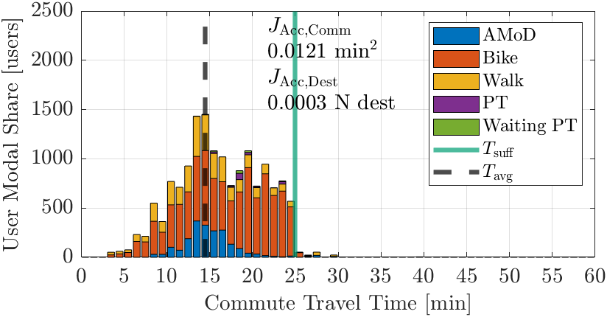
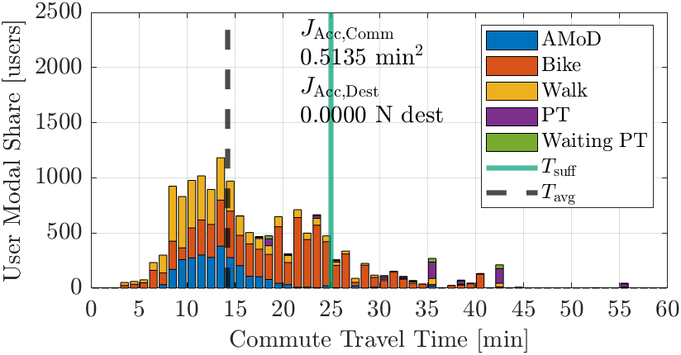
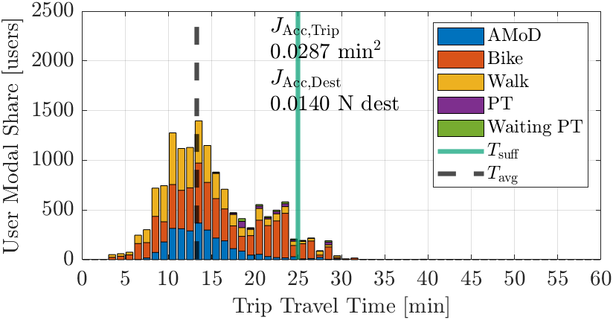
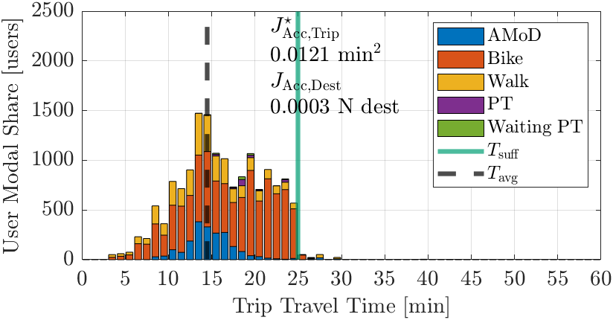
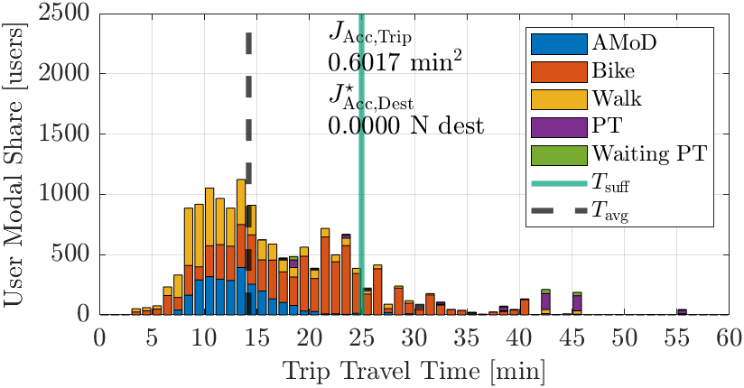
nCar = 3000, Tsuff = 25 min
Metric
Commute
Trip
Objective
Commute Sufficiency
Trip Sufficiency
Accessibility Sufficiency

Slide 26
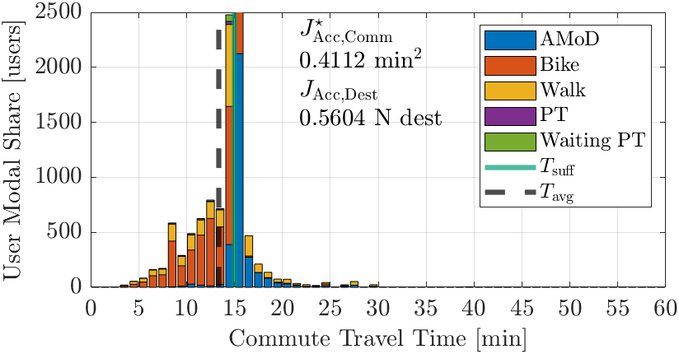





nCar = 4000, Tsuff = 15 min
Metric
Commute
Trip
Objective
Commute Sufficiency
Trip Sufficiency
Accessibility Sufficiency

Slide 27






nCar = 4000, Tsuff = 20 min
Metric
Commute
Trip
Objective
Commute Sufficiency
Trip Sufficiency
Accessibility Sufficiency

Slide 28





nCar = 4000, Tsuff = 25 min
Metric
Commute
Trip
Objective
Commute Sufficiency
Trip Sufficiency
Accessibility Sufficiency

Slide 29






nCar = 5000, Tsuff = 15 min
Metric
Commute
Trip
Objective
Commute Sufficiency
Trip Sufficiency
Accessibility Sufficiency

Slide 30






nCar = 5000, Tsuff = 20 min
Metric
Commute
Trip
Objective
Commute Sufficiency
Trip Sufficiency
Accessibility Sufficiency

Slide 31




nCar = 5000, Tsuff = 25 min
Metric
Commute
Trip
Objective
Commute Sufficiency
Trip Sufficiency
Accessibility Sufficiency

Slide 32
Nsuff = 35

Slide 33






nCar = 3000, Tsuff = 15 min
Metric
Commute
Trip
Objective
Commute Sufficiency
Trip Sufficiency
Accessibility Sufficiency

Slide 34





nCar = 3000, Tsuff = 20 min
Metric
Commute
Trip
Objective
Commute Sufficiency
Trip Sufficiency
Accessibility Sufficiency

Slide 35






nCar = 3000, Tsuff = 25 min
Metric
Commute
Trip
Objective
Commute Sufficiency
Trip Sufficiency
Accessibility Sufficiency

Slide 36






nCar = 4000, Tsuff = 15 min
Metric
Commute
Trip
Objective
Commute Sufficiency
Trip Sufficiency
Accessibility Sufficiency

Slide 37






nCar = 4000, Tsuff = 20 min
Metric
Commute
Trip
Objective
Commute Sufficiency
Trip Sufficiency
Accessibility Sufficiency

Slide 38






nCar = 4000, Tsuff = 25 min
Metric
Commute
Trip
Objective
Commute Sufficiency
Trip Sufficiency
Accessibility Sufficiency

Slide 39






nCar = 5000, Tsuff = 15 min
Metric
Commute
Trip
Objective
Commute Sufficiency
Trip Sufficiency
Accessibility Sufficiency

Slide 40






nCar = 5000, Tsuff = 20 min
Metric
Commute
Trip
Objective
Commute Sufficiency
Trip Sufficiency
Accessibility Sufficiency

Slide 41




nCar = 5000, Tsuff = 25 min
Metric
Commute
Trip
Objective
Commute Sufficiency
Trip Sufficiency
Accessibility Sufficiency

Slide 42
Nsuff = 40

Slide 43






nCar = 3000, Tsuff = 15 min
Metric
Commute
Trip
Objective
Commute Sufficiency
Trip Sufficiency
Accessibility Sufficiency

Slide 44






nCar = 3000, Tsuff = 20 min
Metric
Commute
Trip
Objective
Commute Sufficiency
Trip Sufficiency
Accessibility Sufficiency

Slide 45






nCar = 3000, Tsuff = 25 min
Metric
Commute
Trip
Objective
Commute Sufficiency
Trip Sufficiency
Accessibility Sufficiency

Slide 46






nCar = 4000, Tsuff = 15 min
Metric
Commute
Trip
Objective
Commute Sufficiency
Trip Sufficiency
Accessibility Sufficiency

Slide 47






nCar = 4000, Tsuff = 20 min
Metric
Commute
Trip
Objective
Commute Sufficiency
Trip Sufficiency
Accessibility Sufficiency

Slide 48






nCar = 4000, Tsuff = 25 min
Metric
Commute
Trip
Objective
Commute Sufficiency
Trip Sufficiency
Accessibility Sufficiency

Slide 49






nCar = 5000, Tsuff = 15 min
Metric
Commute
Trip
Objective
Commute Sufficiency
Trip Sufficiency
Accessibility Sufficiency

Slide 50






nCar = 5000, Tsuff = 20 min
Metric
Commute
Trip
Objective
Commute Sufficiency
Trip Sufficiency
Accessibility Sufficiency

Slide 51




nCar = 5000, Tsuff = 25 min
Metric
Commute
Trip
Objective
Commute Sufficiency
Trip Sufficiency
Accessibility Sufficiency

Slide 52
Tsuff = 15 min
Metric
Commute
Trip
Objective
Utilitarian Efficiency
Commute Sufficiency
Trip Sufficiency

